Slide 1
10 High Impact Actions
Building Diversity and Inclusion into Talent Management
Authors: Doyin Atewologun and Roger Kline

Slide 2

Introduction
The actions outlined in this document were developed by the Midlands and East Regional Talent Board (M & E RTB) with input from diversity and inclusion advisors,
Doyin Atewologun and Roger Kline, with the aim of supporting NHS organisations to increase the diversity of their workforce, particularly at a senior level. Following the implementation of these actions by board and governing body members in their own organisations, they would like
to recommend that all NHS leaders in the region implement these actions within their own trusts and CCGs.
Purpose of the 10 high impact actions:
To support trusts and CCGs to design inclusion into their talent management approach across all parts of their organisation, with the aim of increasing the diversity of the workforce, particularly at senior levels and creating more inclusive cultures.
To support the delivery of the ambitions laid out in the Developing People: Improving Care (DP:IC) framework and the vision of the NHS Long Term Plan to create a just culture that leads to outstanding staff engagement and patient care.
To form a part of and support the strategies that organisations will adopt in order to implement the Workforce Race Equality Standard (WRES)¹ and the Workforce Disability Equality Standard (WDES).
To support provider organisations in building towards an outstanding CQC Well Led rating in relation to equality and diversity.
¹ See: https://www.england.nhs.uk/wp-content/uploads/2019/01/wres-leadership-strategy.pdf for details of the current WRES strategy.

Slide 3
Action 1

Slide 4

Action
Be clear about, and then disseminate, a clear “business case” explaining why diversity and inclusion need to be central to successful talent management in your context.

Slide 5
Gather evidence
Use this article
as a starting point
for developing
a business case pertinent to
your context:
www.hsj.co.uk
How and why diversity and inclusion could improve your organisational performance
Why diversity and inclusion are about improving patient care and organisational effectiveness, not
just legal compliance
Why diversity and inclusion must be integral to design and implementation and not be added retrospectively
Additional resources:
The diversity and inclusion revolution: Eight powerful truths (Deloitte 2018).
https://www2.deloitte.com/insights/us/en/deloitte-review/issue-22/diversity-and-inclusion-at-work-eight-powerful-truths.html
An evidence-based approach to diversity and inclusion (Doyin Atewologun, Rob Briner and Tinu Cornish, 2017)
https://www.hrmagazine.co.uk/article-details/an-evidence-based-approach-to-diversity-and-inclusion

Slide 6
Action 2

Slide 7

Action
Ensure recruiters have a consistent idea of what ‘potential’ means in the search for candidates taking on senior roles in the NHS.

Slide 8
Understanding potential
Understanding what is meant by “potential” is crucial
because past opportunities
and past performance are
not necessarily the best
guide to future potential.
Past opportunities may
have been influenced by
bias whilst past performance
is not necessarily a guide to
future potential.
A recent working definition
from the NHS High Potential scheme includes the following:
We believe that everyone has the potential to progress their careers and be successful in their roles. Potential takes many forms and is fulfilled in many different directions. We need all of these talents and abilities - unified through our shared values - to meet the challenge of building and maintaining a truly world class health service.
However we also acknowledge that some will have the potential to progress into board/governing body level leadership roles, and/or national equivalents and to do
so more rapidly than others. These people will necessarily have the motivation and capability (or the potential to develop the capability) to build trust and collaborate across traditional organisational boundaries; lead effectively to address complex or seemingly intractable challenges; ensure the NHS makes real headway in matters of diversity and inclusion; and foster a climate of learning, innovation and improvement
on behalf of patients and citizens.
‘High Potential’ is future-focused - it concerns the ambition, foresight and capability
to respond to future leadership challenges. The future cannot be wholly understood, predicted, or controlled. Equally, high potential should be considered as situational
or cultural (i.e. ‘potential’ in one setting may not necessarily translate into another).
We therefore recognise that our criteria for identifying ‘high potential’ must be broad enough to include a variety of styles and approaches – although this must also be accompanied by the ability to embody the values of the NHS.

Slide 9

The board needs to have an honest discussion, which informs every aspect of recruitment decisions, about what is meant by “potential” and ensure that they really are testing for what is needed. In particular, think carefully about how you are going to test for the values of compassion and inclusion that “Developing People: Improving Care” says are so important for future leaders.
The outcomes of that discussion should be embedded in the organisation’s talent management strategy which should explicitly set out how that is to be done.
Judging whether someone has potential should be influenced by evidence that they understand and can demonstrate the values of the NHS. When recruiters seek evidence of potential, great caution should be exercised not to unintentionally rule out those who may not have had the same opportunities as others in the past.

Slide 10
Action 3

Slide 11

Action
Explain the need for positive action and establish a programme of positive action for under-represented groups.

Slide 12



Positive action
Establish a sustained programme of positive action for under-represented groups, using approaches that are demonstrated to add value.
Coaching should be well evidenced. Mentors need to understand the different experiences white and BAME mentees may have of mentoring. Shadowing can be helpful. Specific skills-based activities on interview techniques may be helpful. Ensuring fair access to stretch opportunities will be crucial.
Evaluate these for outcomes, not just staff experience.
Positive action is lawful and involves policies that attempt to promote equal opportunity by taking into account protected characteristics to positively improve outcomes for those who
are currently disproportionately under-represented.
In the context of talent management, it is important because institutions have proved very resistant to embracing diversity and inclusion. Some employers (e.g. several major police forces and private sector organisations) have built in substantial positive action programmes to help create a level playing field which overcomes some of the inequalities disadvantage and bias have created. Without such action, alongside changing the institutional barriers, there is a risk that change will continue to be slow.
Positive action is often misinterpreted as positive discrimination. Remember that implementing positive action initiatives, combined with a strong rationale for why, is only effective if institution-wide challenges (on outcomes of interviews still being the ‘usual suspects’, for example) are tackled at the same time.

Slide 13
Action 4

Slide 14

Action
Use data and careful listening to monitor and challenge progress.

Slide 15



Using data
Organisations should collect data and be prepared to challenge and expect change within a set period. Questions to explore include:
Whether outcomes of appraisals are less favourable for some groups of staff than others.
Whether some groups of staff appear to have less access to “stretch opportunities” such
as acting up, secondments, involvement in projects which are crucial to career development.
Whether shortlisting appears to disproportionately exclude some groups of staff.
Whether the likelihood of being appointed once shortlisted is significantly lower for some groups of candidates than others.
The NHS collects a great deal of workforce and staff survey data which can be used to monitor and understand (and change) workforce demographics, recruitment, staff development and promotion. High rates of self-declaration and staff survey responses are a precondition of reliable data. In the context of developing
and recruiting senior staff, nuanced data – split by ethnicity,
grade, specialism, and combinations of protected characteristics - may further enhance insights and should be readily available.
It is hard, almost impossible, for individuals to challenge recruitment and development decisions, so organisations must be proactive, using data to identify trends and then challenge departments or occupations that fall short of the targets.
Without reliable comprehensive data underpinning a talent management programme it is very difficult to determine whether
it is being successful and where the blockages are.

Slide 16
Action 5

Slide 17

Action
Set targets.

Slide 18
Understanding targets
What gets measured gets done. Progress on gender equality (for example increasing numbers of women on boards) demonstrates the success of targets. A set of clear goals that facilitate a disciplined approach to change provides interim milestones, tracks progress and creates a sense of urgency. Committing to clear challenging targets, and monitoring progress against these, stimulates performance and gets results (Locke & Latham 2016).
Targets are not quotas, they are measurable goals that organisations set themselves, based upon disproportionate under-representation
of staff with protected characteristics in certain grades, professions, or departments. It is important to articulate why targets have been selected, and how they are different from quotas so that they
“land right”.
Targets are entirely legal and can be used in the same way as
other workforce targets (e.g. for absenteeism, well-being, turnover) to focus attention and to hold the organisation to account. As one report concluded, “the setting of specific diversity goals has been found to be one of the most effective methods for increasing the representation of women and other minority groups”. To do this effectively, organisations need to adopt targets as an integral component of comprehensive strategies to hasten the advancement of ALL talent within organisations.

Slide 19

Using relevant data, set targets for your organisation which will assist your goal of improving diversity and inclusion. These might be to eliminate the difference between the likelihood of white and under-represented groups (e.g. BAME, disabled, LGBTQ+ and/or female diversely-abled groups) candidates being appointed once shortlisted; and to set a target for the proportion of staff from under-represented groups within more senior grades. Once that is done there will need to be agreement
on the measures to be taken to achieve those goals and the
ways in which it will be explained to staff.
A stretching, and yet achievable aspiration for the NHS would be to reach equality in BAME representation across the workforce pipeline by 2028. This aligns with the timeframe announced by the government on this aspiration for the public sector, it is in line with the timeframe for the NHS Long Term Plan, and is the basis upon which the WRES strategy is informed.

Slide 20
Action 6

Slide 21

Action
Check your assumptions and data about “talent” and “development” for bias and act accordingly.

Slide 22

Keeping bias in check
Choose one or two key indicators – starting with access to “stretch opportunities” – and then scrutinise the data on who applies and who actually gets those opportunities.
Similarly, check staff survey data to see whether different groups of staff think there are equal opportunities for career progression and promotion and find out why they are different.
There is no good reason why take up for “stretch opportunities” should be significantly influenced by gender, ethnicity or disability. Nor should access to the best courses or outcomes from appraisals be influenced by these factors.
If they are, senior management need to challenge, seek explanation and agree how this will change.
Checking our assumptions can help us to recognise the powerful impact that biases make in every day decision-making even outside of our awareness, and ensure we have put actions and triggers into place to mitigate or counter the effects of these biases. We can check our assumptions by scrutinising data, seeking alternative evidence (e.g. challenge sweeping assumptions ‘there are no talented BAME potential directors”) or looking for counter-stereotypical examples (e.g. imagine a director who is vision-impaired).
Biases can be exacerbated if our own decision-making impacts on the ability of staff to develop their talent. The NHS will increasingly move towards a model of staff development which emphasises the importance of “stretch” opportunities (experience in different roles such as acting up, secondments, involvement in project teams), sometimes described as ’70:20:10’. Data repeatedly shows that access to these opportunities are subject to bias.

Slide 23
Action 7

Slide 24

Action
Understand the multiple and often subtle ways in which bias affects every stage of recruitment and development despite best intentions.

Slide 25

Understanding unconscious bias
Unconscious (or implicit) biases, unlike conscious biases, are the views and opinions influenced by our background, culture, context and personal experiences that we are unaware of, which are automatically activated and frequently operate outside conscious awareness.

Slide 26
Unconscious biases affect our everyday behaviour and decision making. Their impact on recruitment and development is much greater than is often realised and biases will affect:
Ensure all panel members understand the subtle ways in which bias can creep in.
Insist that shortlists and panels should be diverse and especially includes members who are representatives of groups currently under-represented at that level within an organisation.
It is entirely legal to insist that every interview panel is diverse and this can contribute to mitigating bias and increasing the quality of appointments especially if organisations insist on diverse longlists and shortlists and the shortlisted candidates meet the job specification and essential criteria.
Ensure there is an independent member of every interview panel who understands these issues and is able to challenge other panel members and give the group permission and accountability to reflect on its processes and challenge itself.
How a job is described – the essential criteria and person specification
e.g. over-emphasising technical and financial skills rather than values-driven team and system working skills, or an emphasis on prior experience rather than underlying competencies.
How and where a job is advertised.
What tests are used without considering the potential for bias e.g. situational judgement tests are likely to get the best mix of fairness and prediction of potential.
What informal encouragement and support is given (or not) to apply
and aspire.
How references are written, and how they are read.
How the composition of the panel can affect the fairness of decision making.
What inappropriate factors may influence decisions beyond the interview and tests – assumptions about “fitting in” and being “like us”, as well as stereotypes.
Additional resources:
A Head for Hiring (CIPD 2015) summarises some of the ways bias can creep into recruitment.
EHRC report on the effectiveness of unconscious bias training (2018) by Atewologun, Cornish & Tresh
https://www.equalityhumanrights.com/sites/default/files/research-report-113-unconcious-bais-training-an-assessment-of-the-evidence-for-effectiveness-pdf.pdf

Slide 27
Action 8

Slide 28

Action
Give forthright and frequent feedback at every stage of recruitment and development, reflecting on minimising bias.

Slide 29

Importance of feedback
As an organisation, agree
a process to ensure
the following:
Provide managers with support (and mechanisms for holding to account)
for having effective appraisals and providing developmental feedback from performance
and interviews.
Gather data on patterns
of appraisal rating
and interview feedback collected against protective characteristics and other categories.
Communicate an expectation of opportunity for independent
challenge to patterns
of poor feedback.
Feedback, undertaken fairly and honestly is crucial if staff development is to be sustained and managed effectively. A common concern for staff, especially for some staff with protected characteristics, is poor quality feedback and challenge in both appraisals and feedback from interviews. Such feedback may be untimely (often too late), vague, not linked to specific staff development opportunities, and reflective of inherent biases regarding what ‘talent’ ought to look like.
Forthright and frequent feedback helps talent hone technical competence and leads to developing a reputation for excellence. It is critical for facilitating learning and development into senior management roles, but is also frustratingly private and subjective, i.e. often dependent on the quality of the line management relationship and exchanged in non-public domains.
Relationships between BAME employees and their managers can be affected, unintentionally, by conscious and subconscious bias and by psychological factors that impact on visible minorities more than others. “Protective hesitation” may mean valuable feedback on performance, mistakes or behaviour may be withheld by a manager due to nervousness about being seen as discriminatory. This “protective hesitation” can undermine honest discussions and learning and impact on the individual’s performance, which could affect future job success rates.

Slide 30
Action 9

Slide 31

Action
Role model inclusive leader behaviours throughout development and recruitment and after appointment.

Slide 32


Leadership behaviours
Role model a culture of listening and respect across the organisation. Seek opportunities to gather different people together and draw out diverse opinions. Do this especially when a new change is being considered, envisioned or implemented, such as in implementing the ideas in this document.
Skilfully challenge i.e. ‘call out’ instances of non-inclusive behaviour you observe. Speak out and offer support to under-represented voices when you observe this, e.g. during meetings look out for regular interruptions or co-opting of under-represented others’ ideas and skilfully turn the conversation back to validate the originator of ideas.
Don’t leave it to visibly different ‘others’ to champion inclusion. Find and work with someone who is very different from you, e.g. via informal reverse mentoring, or working with a senior diversity role model to understand their current perspectives and business/organisational challenges they are grappling with.
Inclusive leadership is the extent
to which individuals in positions
of organisational privilege and power enable others access to information, resources and participation in decision-making by being open and available to less powerful others. This is important for inclusive talent management because, when employees feel more included, they feel more team oriented and innovative.
Behaviours should include overt support for diversity and inclusion in the actions of senior leaders, challenge to those leaders who do not exercise such behaviours and the use of data to identify when challenge may be necessary. Inclusive leaders create safe spaces for staff with protected characteristics to share concerns and suggestions. They could also take a visible, personal interest in steps towards inclusion such as ensuring panels are diverse.

Slide 33
Action 10

Slide 34

Action
Get comfortable with
being uncomfortable.

Slide 35

Open about differences
Read and share with
staff the Catalyst guide: Engaging in Conversation about Gender, Race
and Ethnicity in the Workplace (2014).
View the Catalyst guide
This is an excellent way of thinking about how to have more useful honest and courageous discussions about difference, that pave the way for constructive conversations in
appraisal, mentoring
and interview feedback.
Finally, talking about difference is difficult and sometimes considered a taboo and potentially threatening and difficult. Talking about our potential differences and how implicit and explicit biases affect how we define, identify, groom and select talent is important. Being explicit about people’s differences contributes to developing a sense of belonging while being valued for difference (Catalyst, 2014).
Developing People: Improving Care makes clear that compassion and inclusion should be at the heart of good leadership in the future so that needs to be included in all recruitment processes.
Additional resources:
• Mellody Hobson TED talk on being colour brave: https://www.ted.com/talks/mellody_hobson_color_blind_or_color_brave
• Men Advocating Real Change: http://onthemarc.org/home;
• White Ally Toolkit: https://www.whiteallytoolkit.com/

Slide 36
Some additional resources
Developing People Improving Care (2016).
Reni Addo Lodge – Why I’m no longer talking
to white people about race.
The Truth About Mentoring Minorities, David A. Thomas,
Harvard Business Review (2001).
College of Policing Positive Action Practical Advice (2014)
Centre for Evidence-Based Management (CEBMA)
Chimamanda TED talk on the danger of a single story

Slide 37
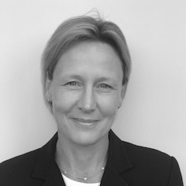
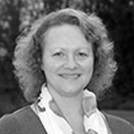
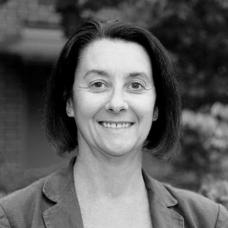
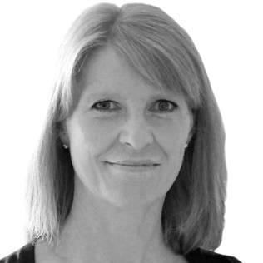
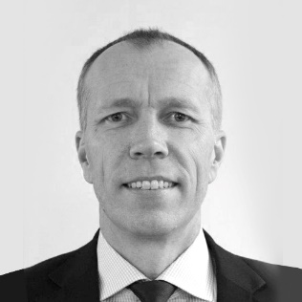
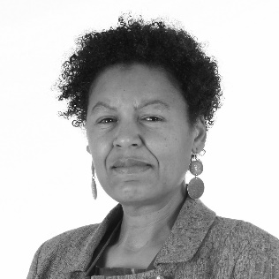
The Midlands and East Regional Talent Board
Amanda Gadsby
Senior Programme Lead, Midlands & East Regional Talent Board NHS
Leadership Academy
Amanda Rawlings
Human Resources Director, Derbyshire Community Health Services, NHS Foundation Trust & Derbyshire Healthcare NHS Foundation Trust
Amanda Sullivan
Accountable Officer
Greater Nottingham CCGs
& Mid-Nottinghamshire CCGs
Clare Panniker
Chief Executive Officer, Basildon & Thurrock NHS Foundation Trust, Mid-Essex, Hospitals NHS Trust and Southend University Hospital
Dale Bywater
Executive Regional Managing Director Midlands & East
NHS Improvement
Danielle Oum
Chair Walsall Healthcare
NHS Trust

Slide 38
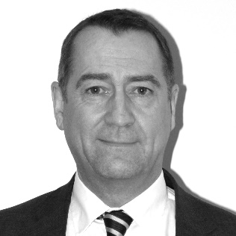
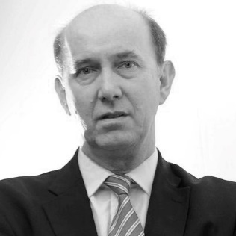
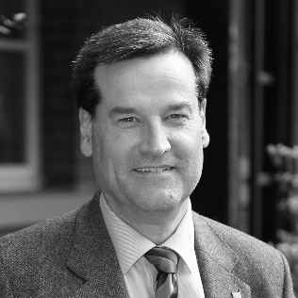
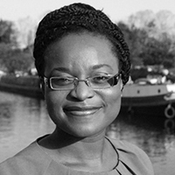
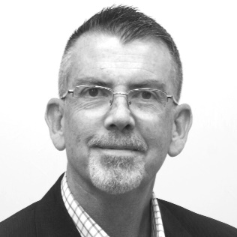
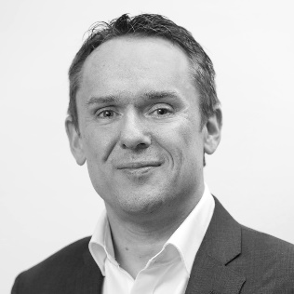
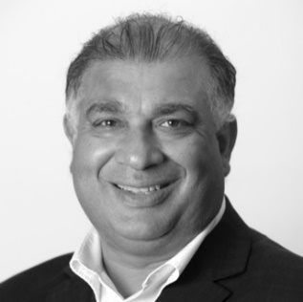
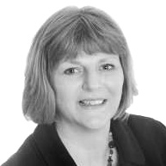
David Farrelly
Regional Director Health Education England
David Sissling
Senior Leadership Advisor
NHS Improvement
Dean Fathers
Non-Executive Director Nottinghamshire Healthcare NHS Foundation Trust
Doyin Atewologun
Inclusion Advisor
Hein Scheffer
Human Resources Director Herts, Beds & Luton CCGs
Ian Hall
Head of Service Improvement Midlands & East
NHS Improvement
Jagtar Singh
Chair Coventry & Warwickshire Partnership NHS Trust
Karen Bloomfield
Director, Head of Leadership East of England
Leadership Academy

Slide 39
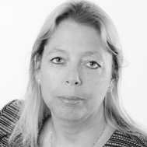
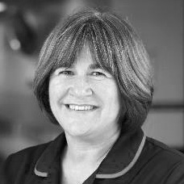
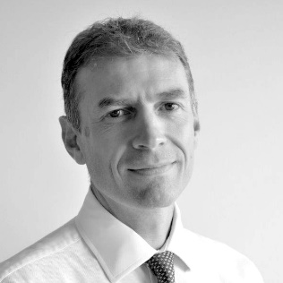
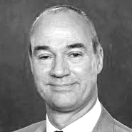
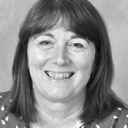
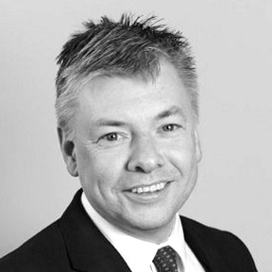
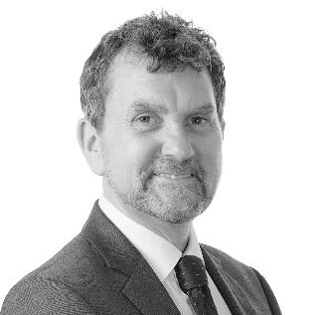
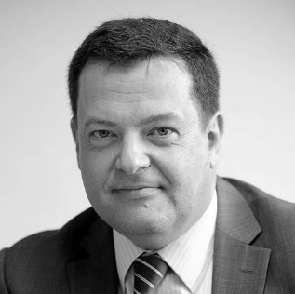
Karen Martin
Chief Information & People Officer University Hospitals Coventry & Warwickshire
NHS Trust
Lynne Wigens
Regional Chief Nurse Midlands & East NHS England
Martin Hancock
National Head of Talent Management NHS
Leadership Academy
Nick Carver
Chief Executive Officer East
& North Hertfordshire NHS
Trust and Chair – Midlands
& East Regional Talent Board
Nicky Hill
Human Resources
Director Nottingham University Hospitals NHS Trust
Paul Maubach
Accountable Officer
Dudley CCG
Paul O’Neill
Director East Midlands Leadership Academy
Paul Watson
Regional Director NHS England Paula Clark Chief Executive Officer University Hospital of the North Midlands NHS Trust

Slide 40
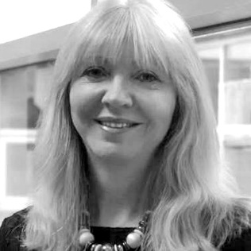
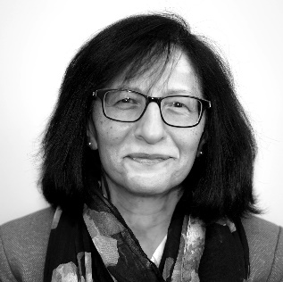
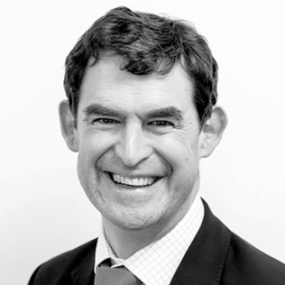
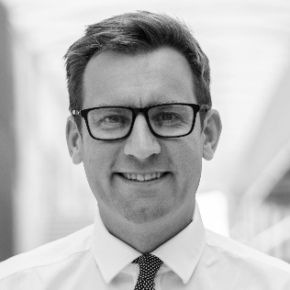
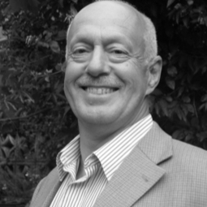
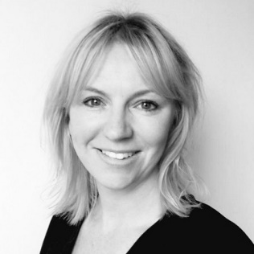
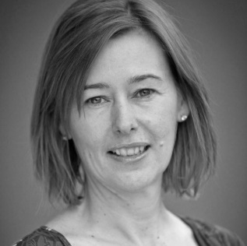
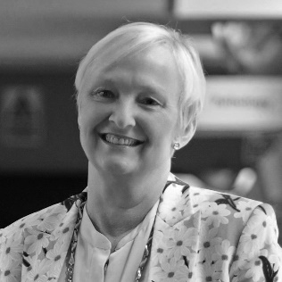
Paula Clark
Chief Executive Officer, University Hospital of the
North Midlands NHS Trust
Rashmi Shukla
Regional Director Public
Health England
Richard Kirby
Chief Executive Officer Birmingham Community Healthcare NHS
Foundation Trust
Richard Mitchell
CEO, Sherwood Forest Hospitals NHS
Foundation Trust
Roger Kline
Inclusion Advisor
Sally Scales
Associate Director,
Head of Executive Search
NHS Leadership Academy
Sam Hepplewhite
Accountable Officer
North East Essex CCG
Sonia Swart
Chief Executive Officer Northampton General
Hospital NHS Trust

Slide 41
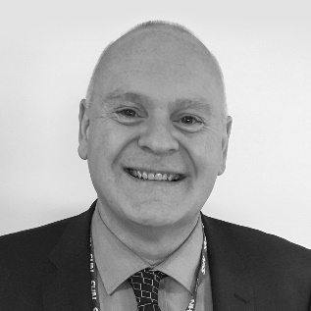
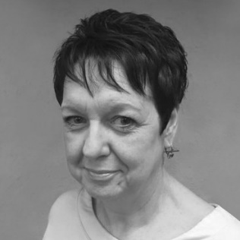
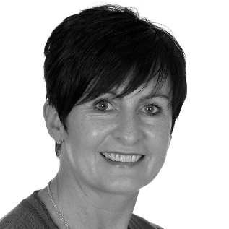

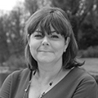
Steve Morrison
Regional Director of HR
& OD Midlands & East
NHS England
Sue Harris
Director West Midlands Leadership Academy
Theresa Nelson
Chief Officer Workforce Development Birmingham Children’s & Women’s Hospital NHS Foundation Trust
Toby Saunders
Chief Executive Officer
NHS Corby & Nene CCG
Tracy Allen
Chief Executive Officer Derbyshire Community Health Services NHS Foundation Trust
The members of the RTB pictured was current at the time of publishing.
Please visit our website for details of the current membership.

