Slide 1

Conscious Decision-Making for Assessment
Presenter: Doyin Atewologun
Authors: Doyin Atewologun and Roger Kline

Slide 2

Introduction
Thank you for watching this presentation.
If you have any technical issues please email them to us using aspire.together@nhs.net and someone will come back to you.
Please put your phone on mute when not speaking and turn off video cameras.
We will circulate slides – last slide suggests some extra reading if you are interested.
Any questions before we start?
Throughout the presentation, we will refer to the work of the Aspire Together Talent Pool, because this presentation was specifically designed to support the assessment process.

Slide 3

This webinar has been created by
Doyin Atewologun and Roger Kline.
We are the inclusion advisors to the
Midland and East Regional Talent Board.
This webinar is a taster on unconscious bias for all those involved in the assessment and interview process
for this pilot.
At the end we suggest some short reading and an excellent short TED talk you may find useful too.
This session won’t get rid of the biases
we all have but it may make you more aware of how they can impede fair selection processes.

Slide 4
These slides are developed based on recommendations from Effectiveness of UBT
by Atewologun et al 2018, Equality and Human Rights Commission.
To make UBT more effective research suggests:
1
Tailor the UB content to your context
  Design the course to specifically address issues identified in your organisational context
2
Seek evidence or engage experts who practice evidence-based work for recommendations for managing & mitigating bias in your context
  Look out for the EHRC review of the effectiveness of UB training – when, where,
  and how it may work

Slide 5
3
Apply established psychological research on learning transfer and behavioural change
  Awareness does not automatically lead to change
4
Plan for how new learning will be transferred and sustained
  Incorporate structural & systemic interventions to embed desired
  behavioural change
This work is done alongside the wider work of the NHS to challenge workforce discrimination. Our aim is to increase awareness of the risks of the biases we all have creeping in unintentionally. You will receive constant reminders of this risk during the assessment process since research shows that can have some impact too.

Slide 6

Agenda
1
Welcome and overview
Context
Bias in recruitment and development
Conscious decision-making in
Aspire Together
  Spotting and mitigating bias
  Noting micro-behaviours
Next steps and resources
2
3
4
5
The session
is in
3 short parts

Slide 7
Context
RTB work to embed diversity and inclusion within the Aspire Together Talent Pool has included:
Key Areas of D&I Activity and Assurance
Specialist Advice and Leadership Academy Alignment
Nomination – strong encouragement for under-represented groups –
with some success
D&I Training & Development
Assessment – content of competencies inc. an inclusion one
assessment process against these competencies
interview process
Assessor briefing pack contents
Monitoring and Evaluation throughout the process – and lessons for Cohort 2

Slide 8

A father and his son were involved in a car accident in which the father was killed and the son was seriously injured. The son was taken by ambulance to a nearby hospital and was immediately wheeled into an emergency operating room. A surgeon was called. Upon arrival, and seeing the patient, the attending surgeon exclaimed, ‘Oh my God, it’s my son!’

Slide 9
What is Unconscious (or Implicit) Bias?
Views and opinions that we are unaware of, yet which are automatically activated and frequently affect our everyday behaviour and decision making.
Our unconscious biases are influenced by our background, culture, context and personal experiences. (Atewologun, Cornish & Tresh, 2018)

Slide 10
Some types of bias
Affinity bias – people like us,
fit in
Conformity
bias
Types of bias in recruitment include...
Halo
effect
Confirmation bias
Horns
effect

Slide 11




What is the impact of unconscious bias?
Hence the need to focus on conscious decision-making that relies less
on our assumptions
We are hard wired to use lenses or filters we use to view
the world
They have evolved from fight vs flight survival responses

Slide 12
Unconscious bias is very powerful and this training
won’t remove it – but can make you more aware:
1
2
3
Orchestras
Headaches
Interviews
Audition – behind screen.
Removal of shoes
to conceal gender.
Occasionally or often?
White vs black candidates – smiles, spoke more, less hesitation, leaned forward, longer interviews.

Slide 13
Practising conscious decision-making

Slide 14

Conscious
Decision-Making
NEXT SECTION

Slide 15

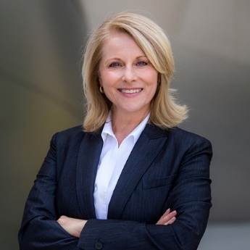

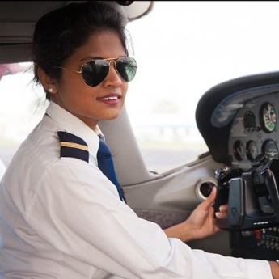


Imagine

Slide 16

What helps or hinders conscious
decision-making?

Slide 17
Some triggers of unconscious bias
When we are hurrying to
make a decision
When we are overloaded
or tired
When in the assessment process is
this likely to happen?
When we are nervous, unsure, lack confidence
When we are under pressure
When we need to access/surmise information quickly
When we see or hear specific characteristics or behaviours that confirms what we already ‘know’ to
be true

Slide 18

When is my bias most likely to be triggered?
When may I need to pay extra attention
to conscious decision-making?
At start of interview –
4 minutes
In decision making “wash up”
At end of interview

Slide 19

NEXT SECTION
Micro-behaviours
Unconscious bias in action

Slide 20

Micro-behaviours
Verbal
Conscious
Non-verbal
Unconscious

Slide 21

“I walked into the interview room and when I put my hand up to shake his hand he was like (showed a limp hand) …There was a reluctance …he was like surprised.
I did feel that like because of his reaction and surprise, did he think that I wouldn’t be as good as anyone else because of who I was? I just felt the need to try even harder …I think it made me want to go into overkill… I thought ‘Serena you should be disappointed with yourself, don’t look too desperate for the job because you’re not, because you know you are worthy of it… Because I thought his negative reaction meant that I wasn’t going to be as good as the others, and I have to try (to) be extra
extra special.”
‘Serena’, Senior black UK female civil servant
(from Atewologun, 2011)

Slide 22
Positive and negative bias ‘leaks out’
How could we spot and mitigate this during the assessment centre?
Micro-affirmations
Micro-inequities
Small, short-lived and hard-
to-see
Often unconscious but very effective,
Occur when we are drawn to others who are like us
‘Small’, short-lived and hard-
to-prove
Often unintentional,
but long-lasting
Occur wherever people are perceived to be ‘different’

Slide 23

Stories through behaviour
Where you sit, how you greet, where you look, who you ask, when you interrupt, how you challenge, and how you do nothing - all tell
a story.
They also tell others a story about who is valued and who is not.

Slide 24
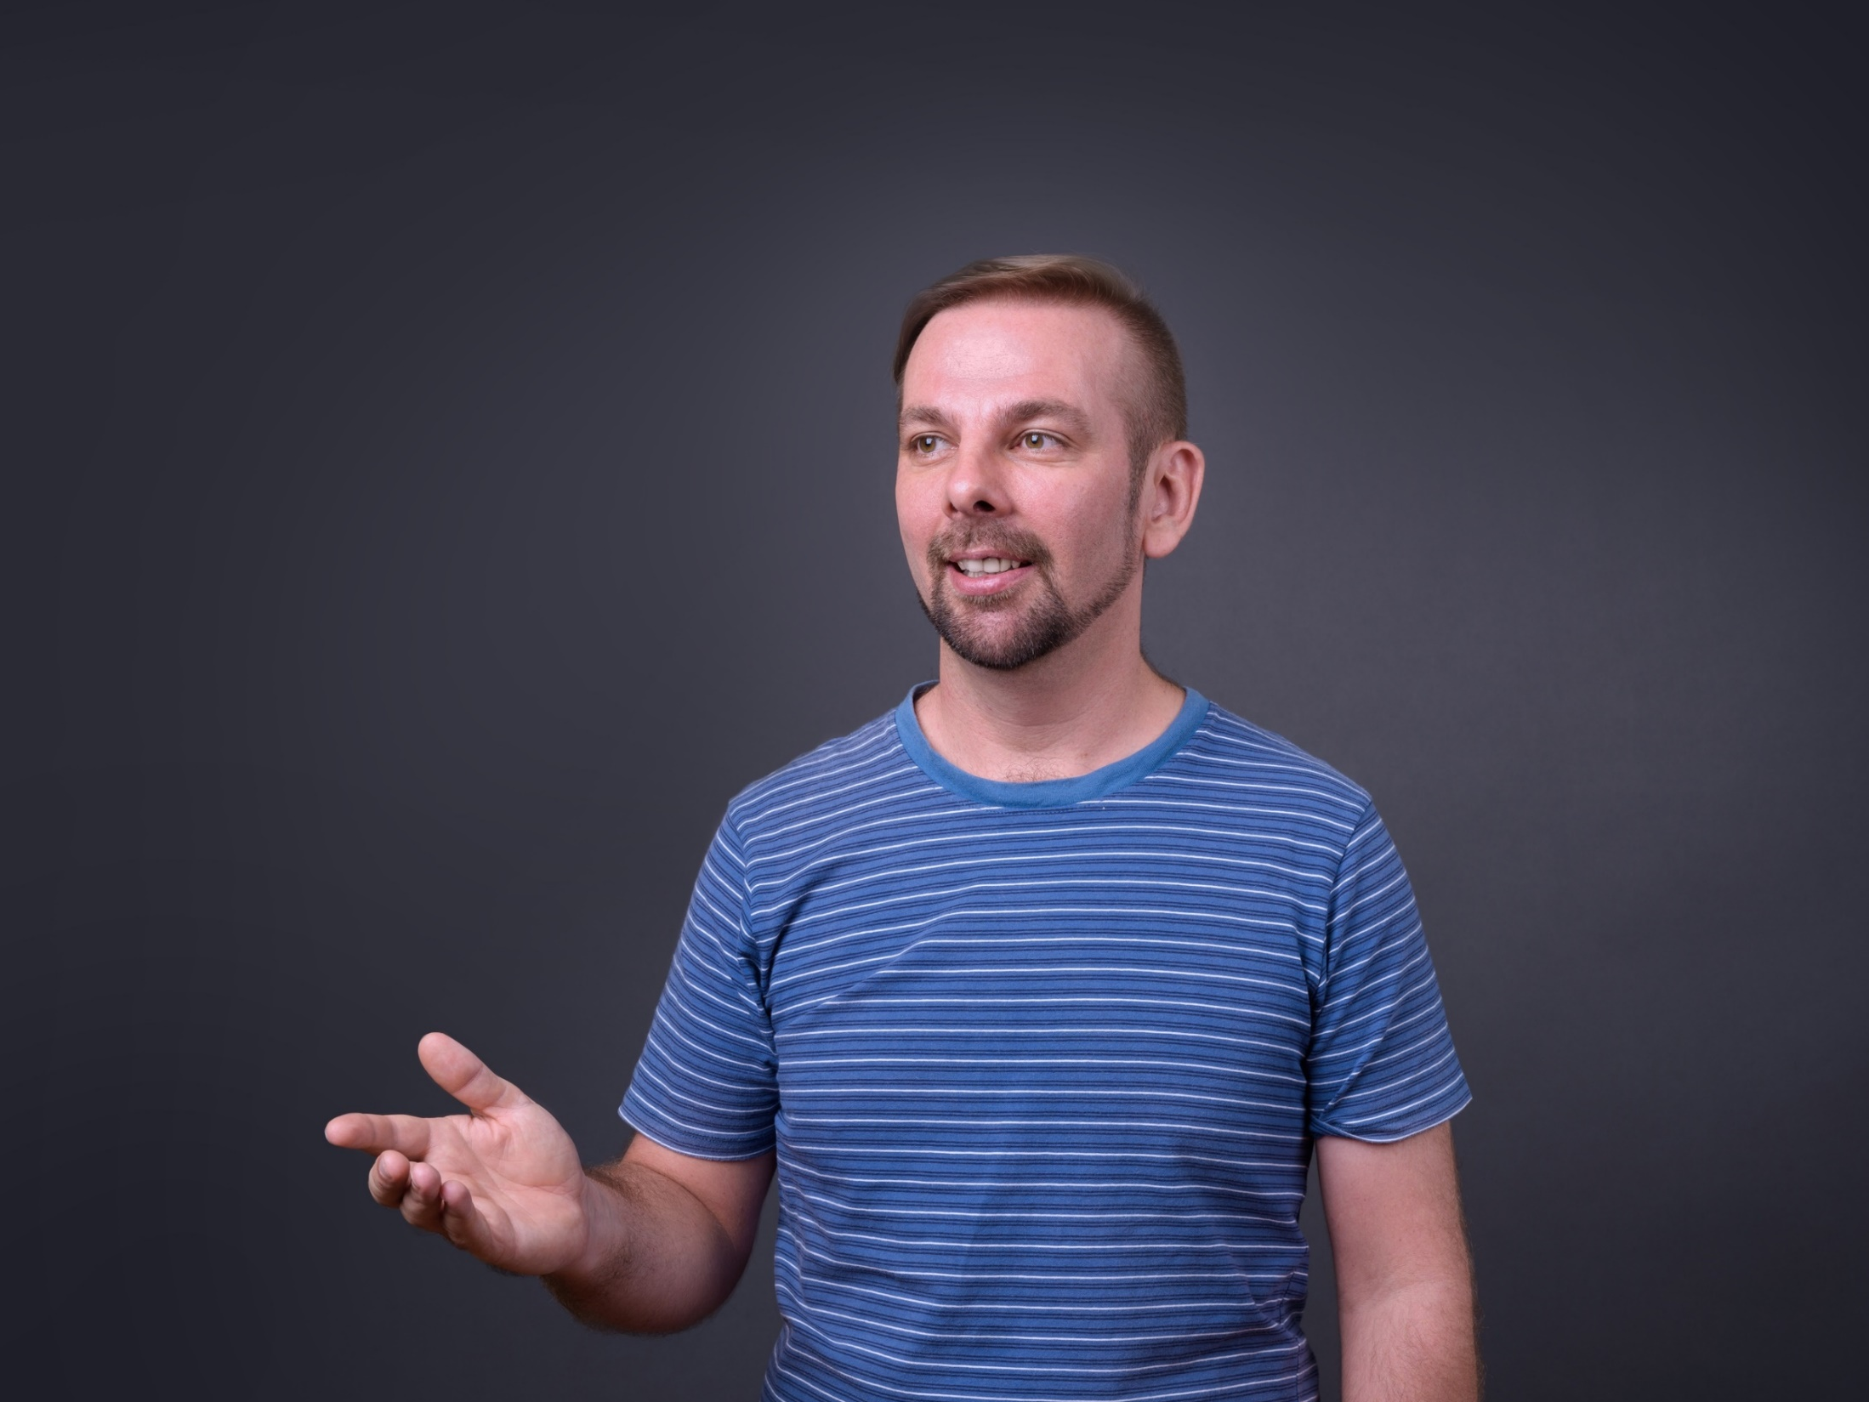
Micro-behaviour signals
Choice of behaviours
Facial expressions
Eye contact
Questions & interactions
Tone
of voice
Hand gestures

Slide 25

IN SUMMARY

Slide 26




We can’t just ‘ignore’ our bias
It’s pervasive
(it impacts even if we try to supress it)
It impedes performance and interpersonal relationships
We are wired to notice ‘difference’

Slide 27

Our approach
TAILOR
Tailoring the unconscious bias content to our context
GUIDE
Engaged experts that practice evidence-based work
for recommendations for managing & mitigating bias
RESEARCH
Apply established psychological research
on learning transfer & behavioural change
PLAN
Plan for how new learning will be transferred
& sustained
CHANGE
How can we make sure training (of any kind)
leads to sustained behaviour change?

Slide 28

NEXT SECTION
Next steps and
additional resources

Slide 29

Making this happen in the assessment centre
Participants are expected to challenge behaviours that permit or enable bias e.g. conformity bias, affinity bias, horns and halo, (within
4 minutes)
Assessor panels must
avoid deference to any one person whether based on seniority or any other attribute
Assessors must bear in mind how the slightest signals (e.g. inappropriate body language) send
a message
Constant reminders about
the multiple and subtle ways bias intrudes are important if learning is to be applied in assessment context

Slide 30

Further reading
EHRC report on the effectiveness
of unconscious bias training (2018)
by Atewologun, Cornish & Tresh
What Works: Gender Equality
by Design by Iris Bohnet
Thinking, Fast and Slow
CIPD Hiring for Managers
The Value of Difference: Eliminating Bias in Organisations by Binna Kandola
Try the Harvard IAT
TED talk: Yassmin Abdel Magied - What does my headscarf mean to you?

Slide 31




Thank you for listening
www.leadershipacademy.nhs.uk/
aspiretogether
aspire.together@nhs.net
Join the conversation #AspireTogetherNHS

