Slide 1
Talent Review Briefing
For Board/Panel Members

Slide 2
Agenda
Talent management – wider context
The process
Purpose, benefits and mindset
Preparation
The Review Panel/Board itself
Succession Planning
Feedback
Q&A

Slide 3
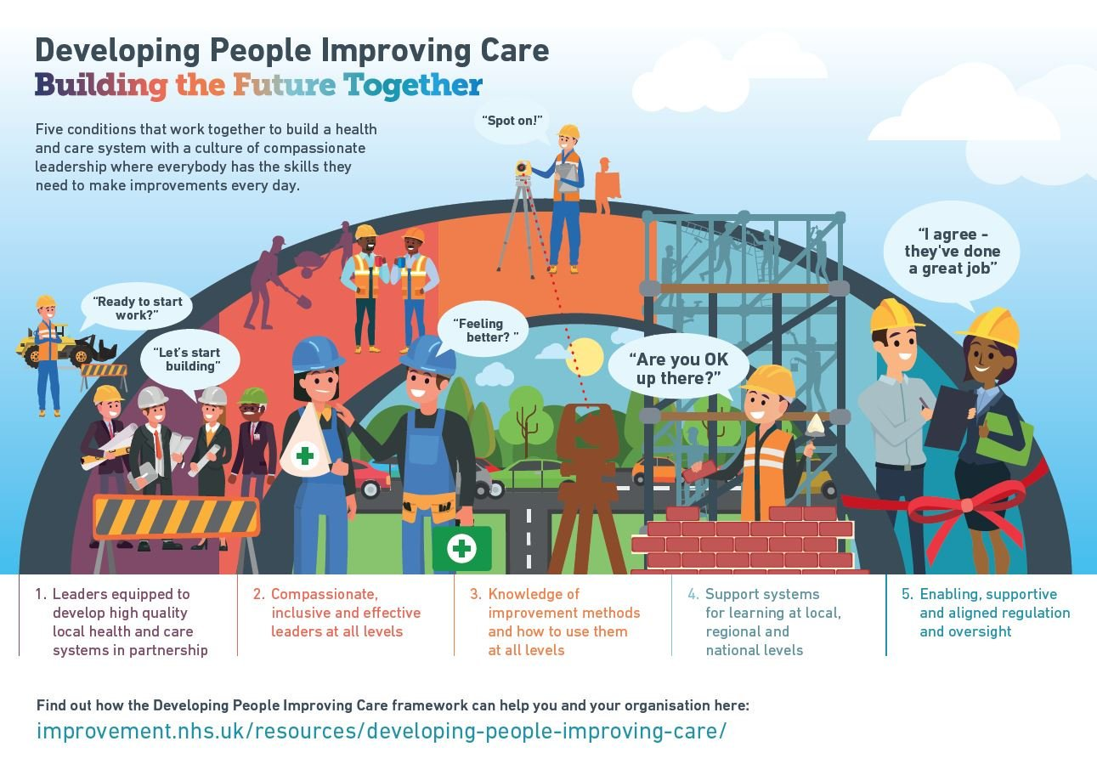
Developing People: Improving Care
Developed by health and care partners and backed by regulators and inspectors
Main purpose: to equip NHS funded organisations to deliver continuous improvement in local health and care systems and to encourage development of a critical set of improvement and leadership capabilities among staff
Critical capabilities:
Systems leadership skills
Improvement skills
Compassionate, inclusive leadership skills
Talent management

Slide 4
Well Led Framework
Strengthens content on leadership, culture, system working and quality improvement
Strategic approach to managing talent
Leadership strategy and succession plan
Flexible, agile responses to change
Participation in pooled activity including local area talent planning

Slide 5
Regional Talent Boards
Primary aims:
Clear visibility of current and future talent at sub-Board level
A better understanding of the profile of and demand for emerging talent pipeline across the region
Acting as ‘One NHS’ in relation to talent
Streamlined approach for identifying , assessing and in the future, mobilising talent

Slide 6
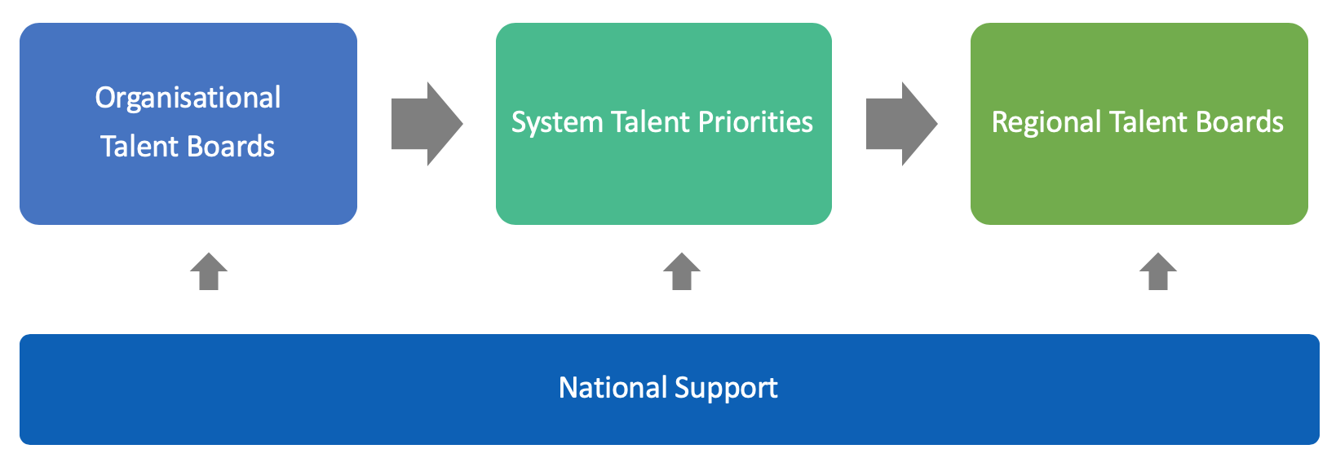
Making connections

Slide 7
Talent Review – purpose and benefits
To encourage people to maximise their performance and potential, and tailor development interventions that are specific to their needs – individual
To inform the organisation’s succession plan, based on robust information – organisation
Readiness to participate in system and regional talent management interventions

Slide 8
Talent Review Process
STEP 3: Line Managers provide brief overview, view and rationale
STEP 5: Contributors provide their evidence/examples
STEP 6: Facilitator brokers decisions about development, succession and feedback
STEP 7: Succession plan finalised, feedback given to individual, actions implemented
STEP 2: Facilitator positions the session and steers discussion
STEP 4: Contributors ask questions, Line Managers responds
STEP 1: Preparation/Briefing

Slide 9
Talent review timeline
Briefings – insert date
Review and Career Conversations (incorporating talent elements) – insert date
Talent Review Board – insert date
Feedback discussions with individuals - insert date
Refinements to the process/documentation – insert date
Suggested checkpoint/follow up on actions – insert date (ideally quarterly, but six-monthly minimum)

Slide 10
Talent Review Mindset
Ground rules – confidentiality, avoid bias, present, evidence
Managing conflicts of interest

Slide 11
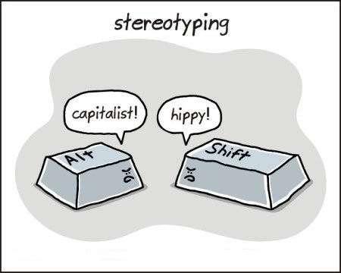
Sources of error
Halo and horns
Leniency
Harshness
First impressions
Recency
Stereotyping
Rushed decision making
Similarity/attractiveness

Slide 12
Unconscious (implicit) bias
Views and opinions that we are unaware of, yet are automatically activated and frequently affect our everyday behaviour and decision making.
Our unconscious biases are influenced by our background, culture, context and personal experiences (Atewologun, Cornish & Tresh, 2018)
We are hard wired to use lenses or filters we use to view the world, hence the need to focus on conscious decision-making that relies less on our assumptions

Slide 13
Triggers of bias
When we are hurrying to make a decision
When we are under pressure
When we need to access/surmise information quickly
When we are overloaded or tired
When we are nervous, unsure, lack confidence
When we see or hear specific characteristics or behaviours that confirms what we already ‘know’ to be true
When is my bias most likely to be triggered?
When might I need to pay extra attention to conscious decision-making?

Slide 14
Other behaviours
Facial expressions
Tone of voice
Hand gestures
Choice of behaviours
Questions & interactions
Eye contact
Where you sit, how you greet, where you look, who you ask, when you interrupt, how you challenge, and how you do nothing - all tell a story

Slide 15
Preparation
Familiarisation with the process/approach
Reflecting on the individual’s performance, potential, aspirations, readiness and development/support requirements
Anticipating responses

Slide 16
Break

Slide 17
Talent Review Structure
STEP 2: Line Manager provides brief overview, view and rationale
STEP 4: Contributors provide their evidence/examples
STEP 5: Facilitator brokers decisions about development, succession and feedback
STEP 1: Facilitator positions the session and steers discussion
STEP 3: Contributors ask questions, Line Manager responds

Slide 18
Talent Review Agenda
Set up
Exceptions
Reviews 1 – 5
Break
Reviews 6 – 10
Lunch
Reviews 11 – 15
Break
Reviews 16 - 20
Reflections, summing up and actions

Slide 19
Talent Review - Roles
Facilitator – chair and manage the structure of the review, manage time, ensure feedback and outcomes are captured, support and challenge as appropriate
Presenter – be prepared to present information about performance, potential, aspirations, readiness, support required and your view on your reports as potential successors – temporary and substantive
Contributor – be prepared to share your experience of working with the individuals being discussed, along with your view on them as a potential successor – temporary and substantive
KEEP THE DISCUSSIONS EVIDENCE BASED

Slide 20
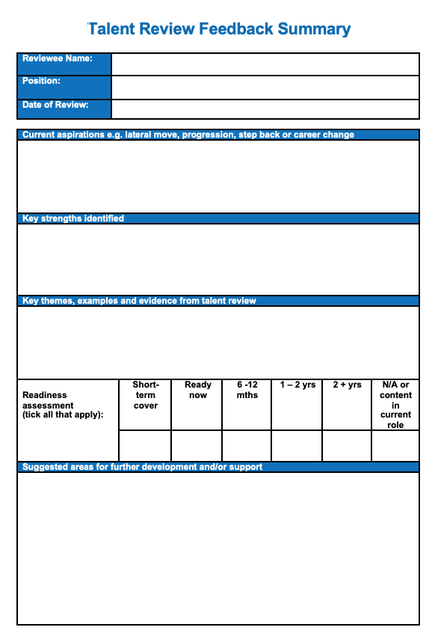
Capturing feedback/outputs
Best practice:
Capture the feedback about your direct reports yourselves
OR
Others take notes about your direct reports so that you can add to the feedback you will be providing

Slide 21
Succession planning
Should be done based on talent conversation!
Often done in splendid isolation!
Can be considered from different perspectives
Top roles
Replacement at different levels
Critical roles
Leadership development
Technical competency
Important to look at succession in the short and long-term

Slide 22
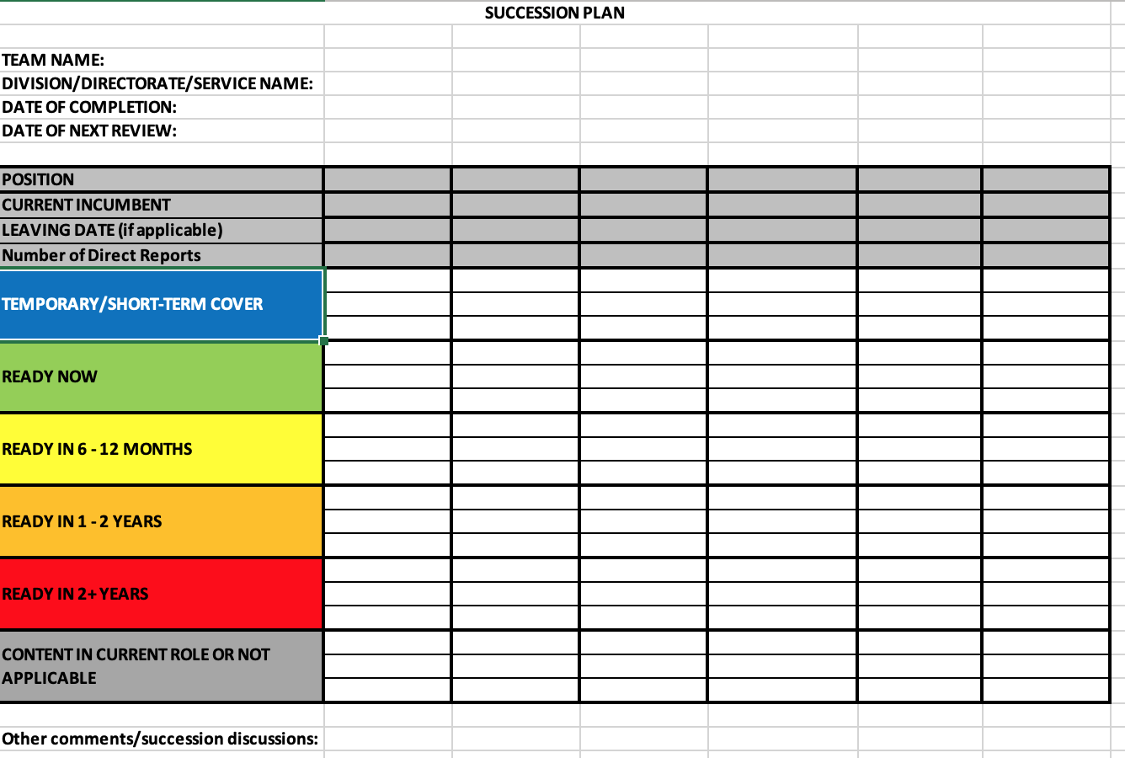
Succession planning

Slide 23
Succession planning
Capturing risks
Role title
Description
Action to be taken
Who is responsible for the action and by when
Mitigating actions
Temporary solutions
Long term solutions
Recruitment implications
Structural/role changes?

Slide 24
Feedback
Consequences of closing/not closing the loop
Feedback within 2 weeks of the Talent Review Board
Two way conversation – coaching approach

Slide 25
Quick recap
Encourage your reports to prepare
Prepare for the conversations yourselves – anticipate potential high and low points so that you can hold considered discussions
Ensure your talent conversations are complete by insert date
Return your documentation insert date
Please contact us if you have any queries/questions

Slide 26
Your questions

