Slide 1
Introduction to the
South East Talent Pools
Applications open until 15 Jan 2020

Slide 2
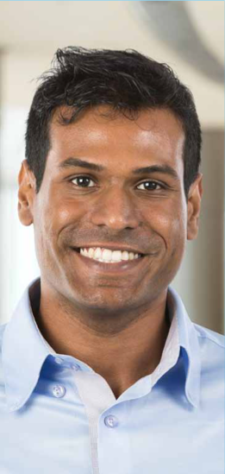
Our new approach to talent
The Aspire Together South East Talent Pools have been created to help us identify and retain our talent.
Talent pools benefit organisations and individuals:
Help organisations manage talent in more collaborative, effective and strategic way across system, addressing board vacancies
Offer aspiring directors increased visibility and opportunities
Individuals assessed as ready for an executive role have their CV shared with potential employees
Individuals needing further development, particularly those from under-represented groups, have access to support.

Slide 3
Fair, robust and transparent
Nationally standardised assessment process, developed by experts.
Already used in other regions with good feedback from nominees and assessors.
In the South East we are seeking to identify:
Ready Now – aspirant directors ready for a board-level role
Future – aspirant directors, particularly from under-represented groups, who may require further development.
The talent pools are not a development programme, but we are developing a Sponsorship for Leadership programme to support high-potential candidates from under-represented groups.

Slide 4
Establishing a diverse, inclusive culture
Unconscious bias and discrimination create barriers for some staff at all levels. We are therefore:
Asking nominating leaders to undertake a short online module on conscious decision-making
Proactively seeking nominations from under-represented groups, including those who require further development
Developing a Sponsorship for Leadership programme to support aspiring directors from under-represented groups
Training inclusion advisers to support the assessment panels.
Under-represented groups
People with disabilities, women and those from BAME and LGBT+ communities are currently under-represented on our boards.
We know that boards and governing bodies make better decisions when they are more diverse and inclusive.

Slide 5
Nominations and assessment
Suitability
All nominees will:
Aspire to a board-level post in the near to middle future
Have been performing well in a senior management position for over 12 months
Have a good awareness of the role of an executive leader in health and care
Be inclusive, compassionate and driven to improve care.
In this phase we are seeking nominees for chief operating officers and HR and people directors.
Nominations can be made by executive directors or as self nominations.
Appropriate nominees to the Ready Now pool will be invited to an assessment centre in March.
Appropriate nominees to the Future pool will be invited to complete a self-assessment to inform and enable further development.

Slide 6
What do I do next?
Nominations are open until 15 January 2020.
We are also seeking:
Assessors
Inclusion advisers
Full details are in the information pack available at:
www.leadershipacademy.nhs.uk/setalentpools
Contact the Aspire Together South East team at:
aspiretogether.southeast@nhs.net
#AspireTogetherSE

