Slide 1
NHS Leadership Academy All staff cascade
13 May 2019

Slide 2
Aim:
“An opportunity for colleagues to meet in order to hear updates, and to be heard, regarding any issues, opportunities, or risks.”

Slide 3
Agenda
Welcome
NHS E/I Exec Group update
Request for team feedback (3 questions)
Academy update and organisational change
Thank you and next meeting

Slide 4
4 takeaways from our Exec Group
Simon Stevens chaired the second meeting of the new Exec Group on Tuesday 16 April. Amongst the various matters we discussed:
2019/20 System Planning | Long Term Plan Implementation | Oversight regime for performance | Culture
We reviewed the latest position national and regional 2019/20 system planning position. All bar eight trusts have now agreed their control totals, a major improvement on prior years. There are a handful of local systems where there remains a planning gap, and our regional teams will be engaging with them closely over the next couple of weeks, so that each of our seven regions achieves a balanced position across commissioners and providers. | We discussed the progress that has been made on developing the LTP implementation framework, which is expected to be published by the end of next month. The framework will set out both strategic and operational planning guidance and will support the creation of locally owned plans that will drive the transformation of the NHS over the next five years. We agreed that the process should give systems the space to craft their narrative and frame their plan in a way that best meets their local and population context but in a way that will allow consistent and aggregatable national tracking of finance, workforce, activity and service improvements. | We noted the latest March 2019 performance figures and noted the improvements in care over the past winter are due to the hard work of NHS staff, whilst also acknowledging the continued pressure under which frontline services continue to operate. This has been the first winter in five years where headline emergency care performance improved, despite successfully treating an extra 380,000 A&E patients within four hours compared with the same time last year. We discussed the arrangements for executive oversight of NHS operational and financial performance as part of our newly combined NHSE/I operating model. | We discussed progress being made to reshape the culture of our joint organisation, which we will also discuss at the Joint Leadership Forum in June. Simon Stevens and a number of the newly appointed national directors will be visiting staff in our local offices in every region of the country in May and June, and we will shortly confirm dates and locations. The Exec Group will also now regularly rotate its meetings around the country, starting in June and July.

Slide 5
Team feedback
How is everybody doing?
Is there anything you’d like to share with the NHS Executive Group or another team?
What successes would you like to share?

Slide 6
Academy priorities and work
Business plan
Interim people plan
Organisational change

Slide 7
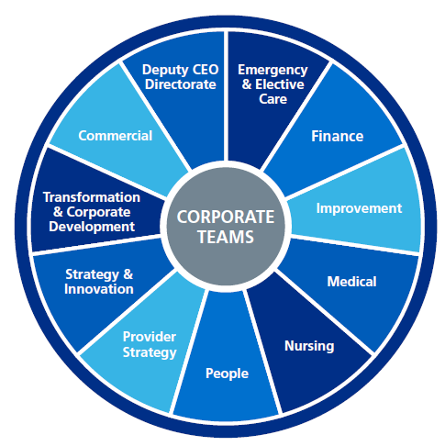
The Context of change
The NHS Long Term Plan
The NHS Interim People Plan
A New NHS Operating Model and People Directorate
Making the NHS the best place to work
Inclusive and compassionate leadership
Honest assessment of shortages – nursing is the most urgent
Cross disciplinary and 21st century working
Collaborative and continued work on the people agenda
Our Work
Seven regions and 11 corporate directorates.
Creation of a People Directorate to have responsibility for delivery of the NHS People Plan.
Transfer of the NHS Leadership Academy into the People Directorate to set, and implement, the strategy for the NHS across leadership and talent.
Academy vision:
Outstanding leadership at every level of the NHS creates cultures of compassion and inclusion that improves lives in local communities.
System Development that enables
service improvement
across health and care
Enable, convene and support whole system talent management
Strategic Objectives
Provide leadership development interventions that have reach and impact across the service

Slide 8
The process
Stage 1: Preliminary moves. Jan-April 2019:
TUPE of the NHS Leadership Academy into NHS People Directorate
Stage 2: Preparation and drafting. April – June 2019:
Preparation of new organisation design to support new operating model. Including assessment of which roles are in and out of scope for the change. Where it is proposed to change roles, new Job Descriptions will be drafted.
Stage 3: Collective consultation. July – Aug 2019:
From 3 Jul collective consultation on the shared structures. You can ask questions, give feedback and have the opportunity to attend sessions with your team and senior leaders.
Where new Job Descriptions have been prepared these will be compared to existing job descriptions in order to make a judgement on individual outcomes.
Stage 4: Outcomes and check/challenge. Sep – Oct 2019:
In mid-September the final outcome from the consultation is published including individual outcomes. There is a “check and challenge” process where you can challenge any outcomes that relate to how your role is impacted.
Stage 5: Closure. By Nov 2019:
All roles appointed to, new teams formed and NHS E/I fully in new operating model.

Slide 9
Thank you and next steps
Whole organisation change process working group
Feedback through weekly team meetings
Shared information on organisation change through the NHS E/I ‘Hub’
Immediate questions or discussion through the sidebar
Next staff exchange on 29 May

