Slide 1
Line Managers Briefing Session
People Directorate Collective Consultation
30 July 2019

Slide 2
For line managers
Introduction
Your role during the consultation
Resources and support available
Questions and discussion

Slide 3
Line managers role in consultation
Be present for people and your team
Support the individuals to contribute to the consultation
Support the team to contribute to the consultation
Raise risks
Critical to enabling this is all line managers understanding the process and available resources

Slide 4
Managers Supportive Conversations
Reaction | Techniques
Denial - a coping mechanism to help individuals resist loss | Encourage them to be honest with themselves Create opportunities for two-way communication asking for their thoughts and feelings Offer explanations to their Qs and respond honestly Coach them to find their own solutions to problems Repeat key messages a number of times, explaining the context and need –more often than you think you need to!
Resistance - a natural reaction to change due to anxiety and uncertainty | Acknowledge their fears and concerns Be clear on the need for change Describe a vision of the future and celebrate early success Show personal commitment to the change Focus on the benefits and explore what the change will mean for them, the team and the organisation Involve them in planning and decision making – resistance is feedback!
Anger – Challenging behaviour as a result of anger or fear | Ask yourself what is acceptable behaviour in line with our values and behaviours and take action as appropriate Decide what you are willing to tolerate, dependent on the change taking places and give constructive feedback As a manager you still need people to be productive and not unsettle others Help them to connect to their new circumstances and involve them as much as possible
Notes:
Are you noticing some difficult conversations happening or anticipating this? This is normal in a change process as we go through the transition. By understanding this line managers can help colleagues when talking with their team members.
What is happening. Stand back and review the issues, is it denial, resistance and/or anger?
You can help your colleagues by holding a mirror up and helping them think through what the issue is for them that underpins their question.
From and E, D and I point of view what is happening? What support can you give them and can you help guide them to the support offer we have as well.
These can be hard conversations to have so make sure you get support if you need it. Ask a peer or your line manager for a coaching style conversation to talk through what happened. Sometimes the issues your colleague is asking you about will be the same for you as well – try to see that when it happens and afterwards think about how you can get support too.
Make sure you understand your boundaries – as an officer of the organisation you have a role to play, but you can’t do everything for everyone. Ask your line manager for help or your local HR contact.

Slide 5
Eight Actions For You
Map out your team meetings and 1:1s from now till the end of November – get ahead inclusively
Update ESR records – have a team ESR refresh
Contact all colleagues out of the business
Ensure all colleagues have clear work goals over this time
Make sure you or a deputy can cover this time period so colleagues know where to go
Learn all you can about the content of the consultation so you can explain it to your colleagues and contribute
Understand and use the line management essentials – review the wellbeing offer so you can explain it
Review your own needs and support for this period
Notes:
Recap – key things to do…

Slide 6
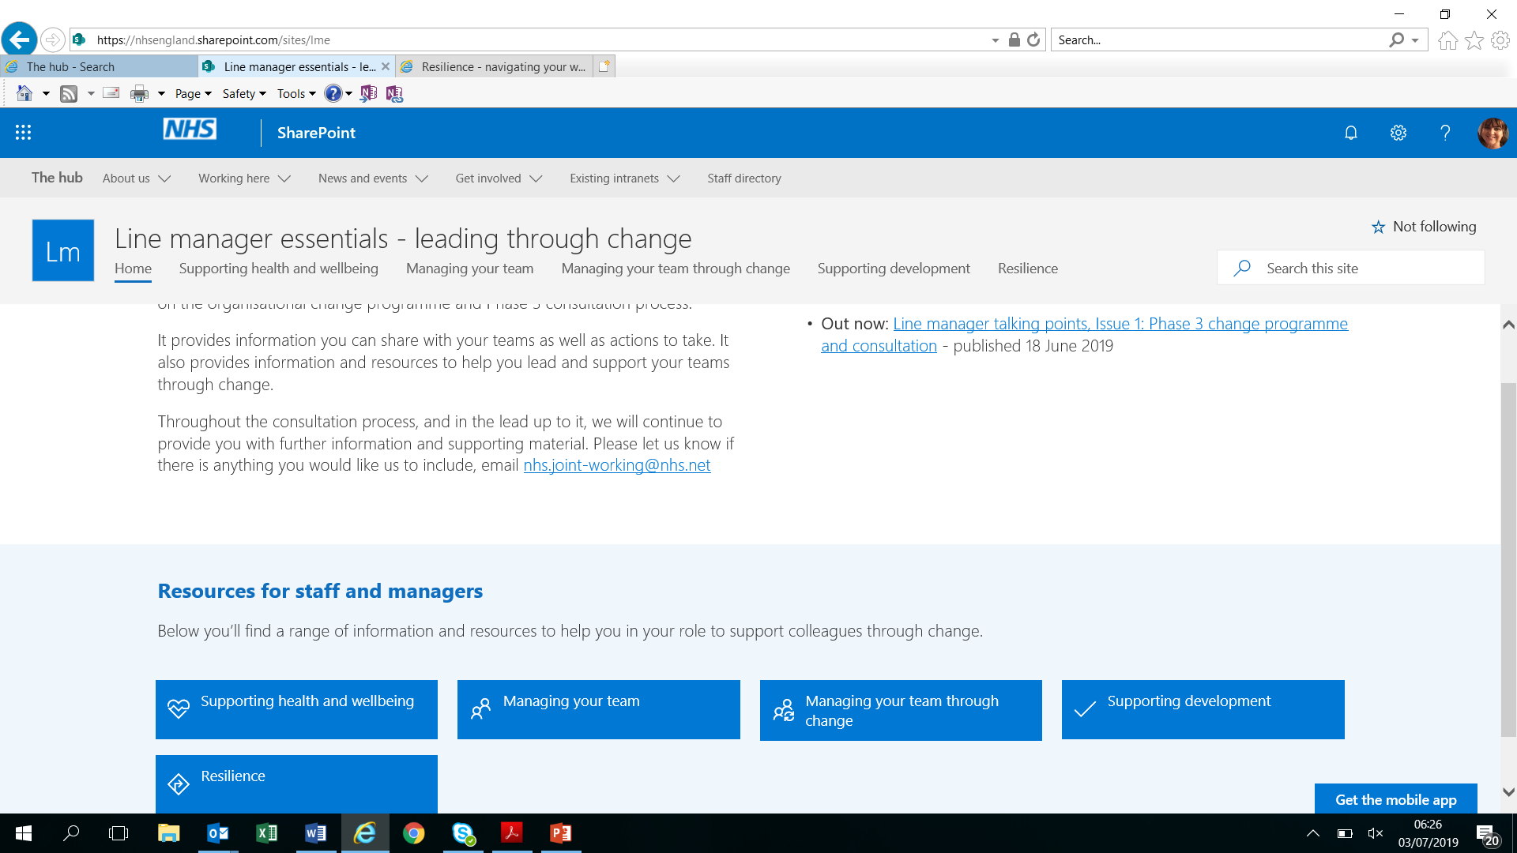
Resources
Take some time to look through this intranet page for our line managers
Hub – Line Manager Essentials – Managing Through Change
Line Manager Essentials Page
Notes:
We have created a great resource page – all our subject matter experts have collated helpful resources under clear headings for colleagues to use.
Please open the hyperlink and walk colleagues through the site. The site has been shared through the ESM cascade already. Open the five blue boxes and show them what is there – there is loads and it is helpful so just a practical note here to walk colleagues through the headlines in each of the five boxes so they can go back in and use this page.
Please show them the content headings in the five links and walk through the Wellbeing offer – the content is set out here. We find this offer is not always understood and it is comprehensive so please make sure you talk through this area. We want our line managers to understand what is available so they can signpost.

Slide 7
Wellbeing Support
Stress and Mental Health
The following can be accessed via the Hub:
The HSE Stress Talking Toolkit is designed to be used to help line managers frame an initial conversation about stress.
The stress assessment template is helpful to complete with your team members to record your conversation and agreed actions.
A referral to Active Care can be made within the first two weeks of a stress-related fit note. (Delivered by our EAP provider).
Our Supporting Your Mental Health presentation gives a helpful overview of services available and the Mental Health page of The hub has links to our Mental Health First Aid Networks.
The 5 Step Guide for Managers gives a helpful overview of how to begin to support positive mental health in the workplace, and the MHFA Line Manager Resource is a more in-depth resource to equip managers to start a conversation about mental health.

Slide 8
Confidential Advice
EAP - line manager support - Our Employee Assistance Programme (EAP) offers a separate confidential line manager support line which is available 9am to 5pm, Monday to Friday via 0800 716 017.
EAP - staff support - All colleagues are entitled to free, confidential telephone support services 24 hours a day, 7 days a week through our EAP via:
Telephone 0800 783 2808 using the employer code: 72936
Online www.healthassuredeap.com using 72936 for your username and password
Download Health e-Hub from the Apple or Android app store and use the code 72936 for your username and password.

Slide 9
What’s Next?
End of the Consultation:
All views and opinions considered
Consultation Outcomes Report developed – Shared with staff 23rd September
Early October – Individual check and challenge
Oct-Nov: Process for slotting, matching and interviewing will start:
  Pool A – limited ringfence: 10th – 18th October
  Pool B – Wider ringfence: 4th – 27th November
  Internal National (Pool C) – same band
  Internal Open recruitment – same band/one below
  External recruitment
Notes:
At the end of the collective consultation process we will bring together all the views and opinions expressed so that we can review the proposals accordingly.
A Consultation Outcomes Report will be developed which will summarise the main themes from the feedback received during the consultation period, and what has changed as a result.
The Consultation Outcomes Report will be shared for information with the trade unions and all affected staff.
It may well set out a revised structure for the 19 parts of the organisation – this is likely to be the case so please make it clear what is shown in the consultation document may change.
Slotting, matching and interviewing will be the next part of this. The way this will be done will be set out in the consultation document. There will be more support to line managers as we move towards slotting, matching and interviewing.

Slide 10
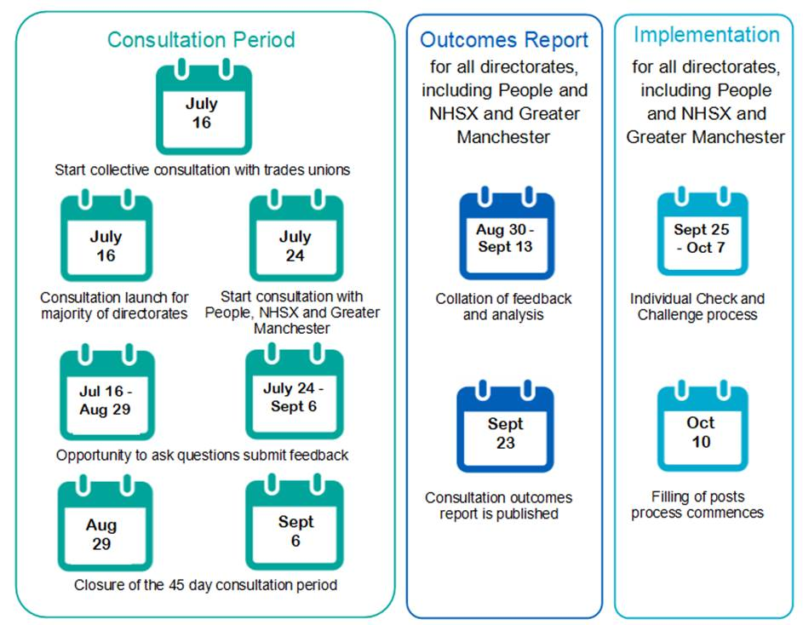
High level timeline and key dates

Slide 11
Questions and feedback

